Slide 1
寵物住宿服務
Sep
Oct
Nov
Dec
Jan
Feb
Mar
Apr
May
Jun
Jul
Aug
A
B
C
MSIT56 No.3
朱羽珊
2023/12/26
D
E
F

Slide 2
動機
目標
作品展示
Sep
Oct
Nov
Dec
Jan
Feb
Mar
Apr
May
Jun
Jul
Aug
A
大綱
B
C
D
題目發想的契機
練習架設網站
構想需要的網頁功能及後台需蒐集的資料
E
F

Slide 3
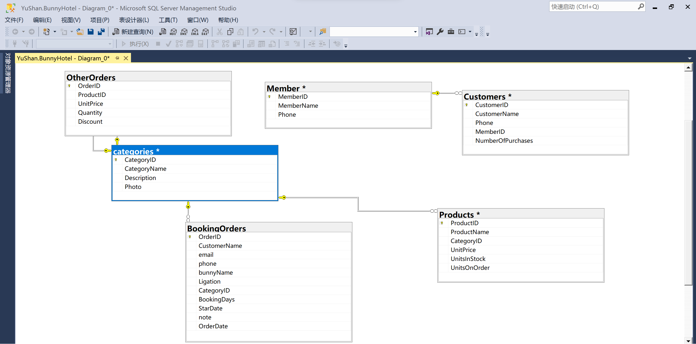
Step by step I will achieve my goals
Sep
Oct
Nov
Dec
Jan
Feb
Mar
Apr
May
Jun
Jul
Aug
A
B
Mercury
Venus
C
Earth
01
04
05
03
D
02
06
Saturn
Mars
E
Jupiter
F

Slide 4
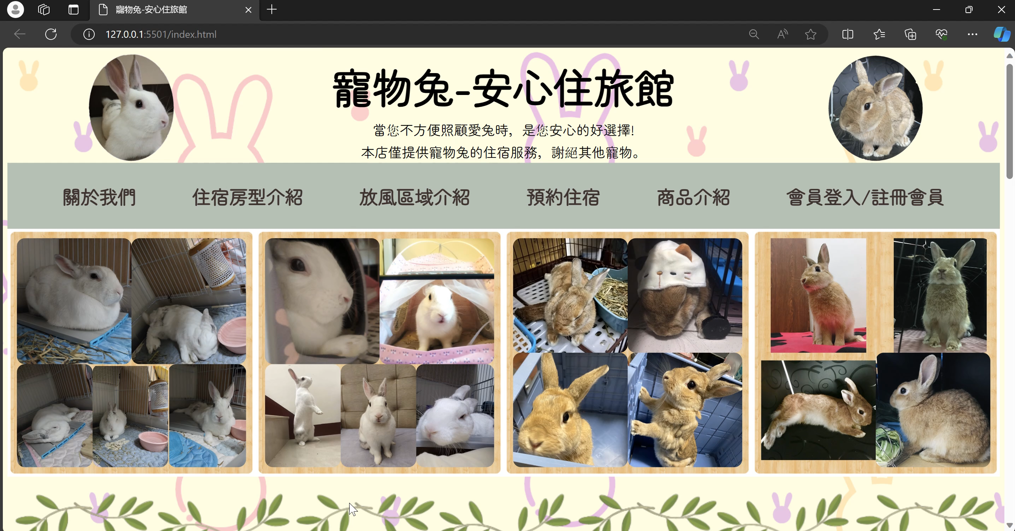
Sep
Oct
Nov
Dec
Jan
Feb
Mar
Apr
May
Jun
Jul
Aug
作品展示
A
B
C
D
E
F

Slide 5
Thanks!
Sep
Sep
Oct
Nov
Dec
Jan
Feb
Mar
Apr
May
Jun
Jul
Aug
A
B
C
D
E
F

